Slide 1

Performance Report of the Vrinda Store,2022
A comprehensive review and strategic outlook
Presented by : Anindita Roy

Slide 2
Index
Project Background
Business problems
Data sources
Data Cleaning Process
Output
Key Insight
Strategic Advice

Slide 3
Vrinda Store is one of the selling partner of various online selling stores like Amazon, Flipkart, Myntra, and many more. Customers order their products and as a seller, the Vrinda store dispatch the products through the relevant delivering partner.
Now the store management wants to review all the sales reports of 2022 and wish to know which segments are doing better and which segments need different strategy to contribute significantly more to the revenue earned by Vrinda store.
Project Background

Slide 4
For the Vrinda store market scenario analysis, we have made some questions for analytic purposes and may those answers will help them to increase their sales and give them a proper visualization for the next year. 1. Here we will know which month has got the highest sales for the store.
2. Which gender has contributed the most revenue?
3. Most populated channel for the store which created the highest sales
4. In these various age group, they want to know which group are the most interested in case of purchasing
5. In the various categories of clothes, which category is in the top position?
Business Problems

Slide 5
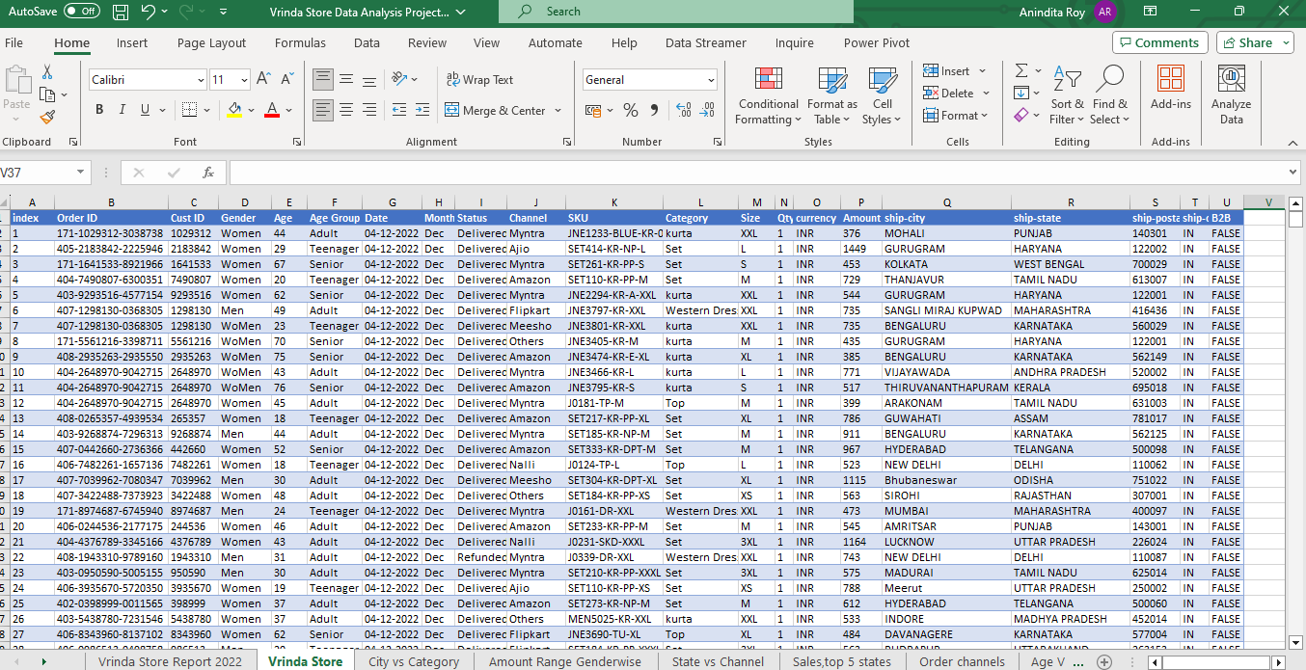
Data Sources
Source: Data collected from Vrinda Store for the year 2022.
Dataset Size: Contains 21 columns and 31,047 rows.
Purpose: Used for comprehensive analysis and strategic planning for the upcoming year.

Slide 6
Handling Missing Values
Removed incomplete records to ensure dataset integrity.
Correcting Spelling Mistakes
Standardized text to correct misspellings and improve consistency.
Removing Duplicates
Eliminated duplicate entries to prevent data redundancy.
Normalizing Data Formats
Standardized formats for dates, measurements, and currency.
Data Validation
Cross-checked data against original sources to ensure accuracy.
Data Cleaning Process

Slide 7


Gender wise purchase
Sales performance by channels
Purchased rate by age group
36% | 64%
30-49 age group having maximum sales
Month wise sale
March and August having maximum sales
Category wise performance

Slide 8
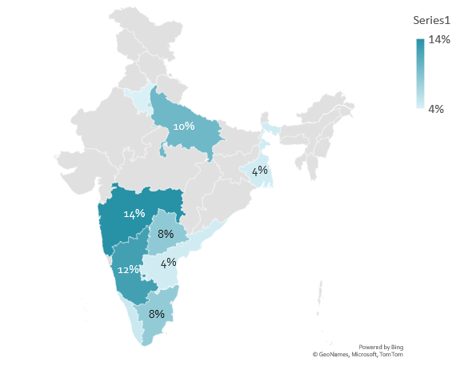
Sales performance by states
Regional Sales Insights Top Selling States
Maharashtra (14%), Karnataka (12%), and Uttar Pradesh (10%) lead in sales volume across the nation.

Slide 9
Key Insights
Peak Sales Months
Maximum sales occurred in March (₹1.93 million) and August (₹1.81 million).
Gender-Based Purchasing
Women accounted for 65% of total product purchases.
Sales Channels
Amazon led with 35% of total sales, followed by Myntra (23%) and Flipkart (22%).
Age Group Purchases
Adults (50%) represented the majority age group (30-49) for purchases.
Top Performing Categories
Set (40%), Kurta (34%), and Western wear (13%) were the best-performing product categories.

Slide 10
Strategic Advice for 2023
Target Women Aged 30-49
Focus on women in the 30-49 age group with tailored offers and coupons to boost sales.
Leverage Peak Sales Months
Provide special promotions in March and August to capitalize on historically high sales periods.
Attract Male Customers
Introduce more targeted offers and incentives to increase sales among male customers.
Enhance Online Channel Offers
Increase promotions on Amazon, Flipkart, and Myntra to drive more sales through these top channels.

Slide 11

Thank You…

